Slide 1
Models of the motor system
Spring 2025
Opher Donchin

Slide 2
Part 1
Illusions and Perception
Perception is a constructive process
Transform signals into internal models
Illusions reveal underlying computations

Slide 3
Sensation and perception
Last class we studied sensation
How does the information get into the system
Today we’ll talk about perception
How does the information get processed
Into what we experience
Into a model of what is out there

Slide 4
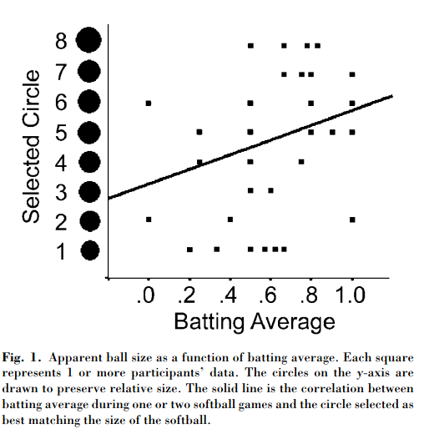
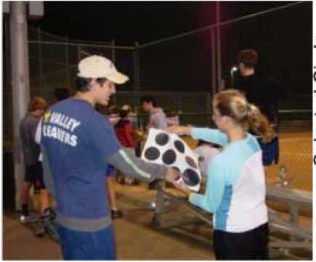
Better hitters see a bigger ball
Witt Psychological Science 2005 16:937

Slide 5
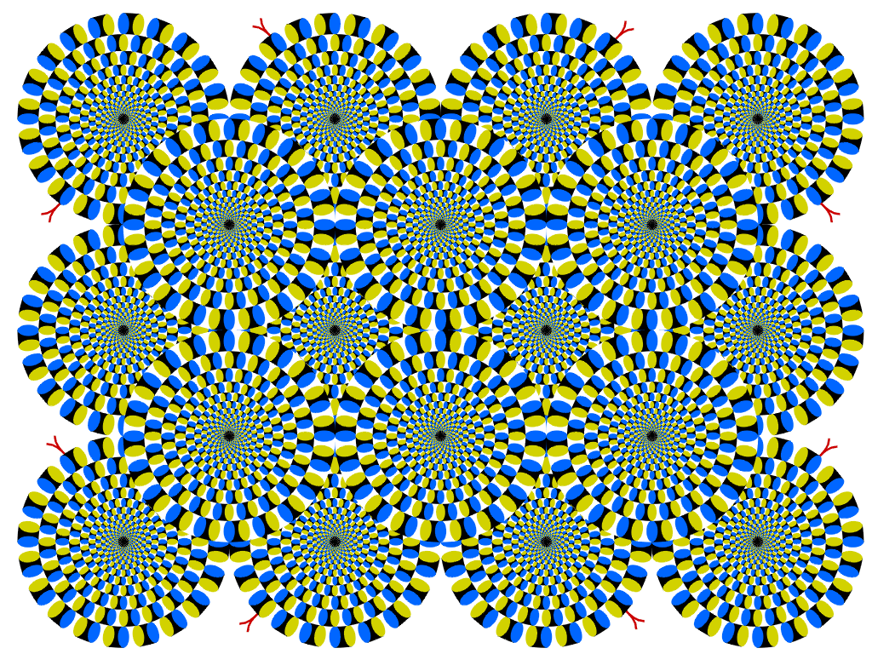
Study perceptions through illusions

Slide 6
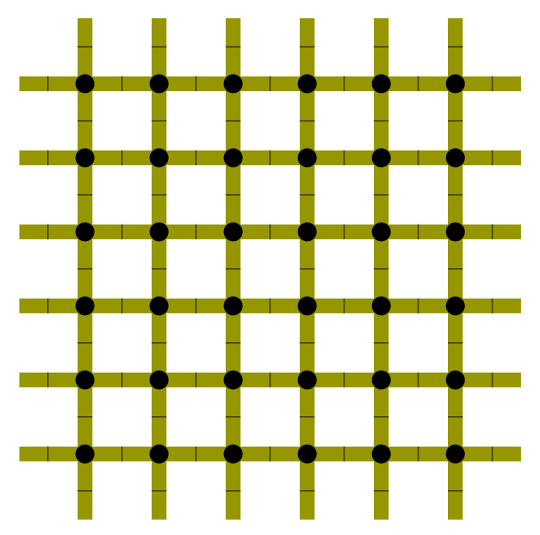
Retinal contrast calculations create this illusion

Slide 7
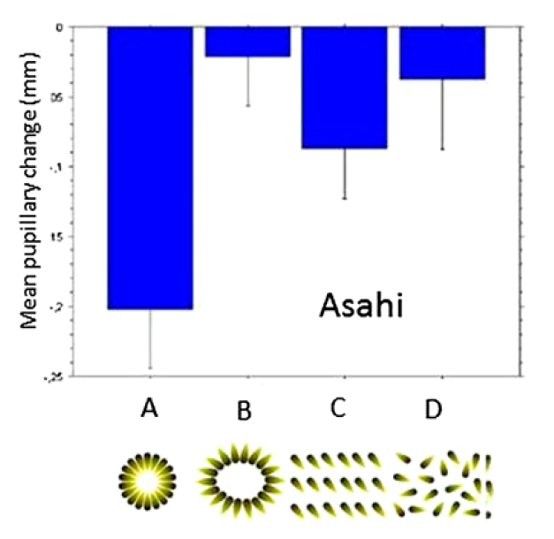

This illusion affects pupil size
Laeng PNAS 2012 109:2162

Slide 8

Stronger version of the effect

Slide 9
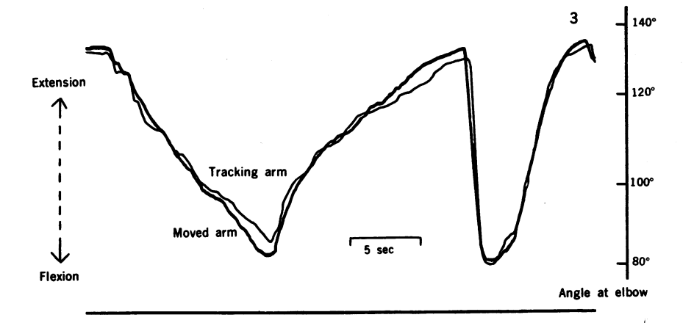
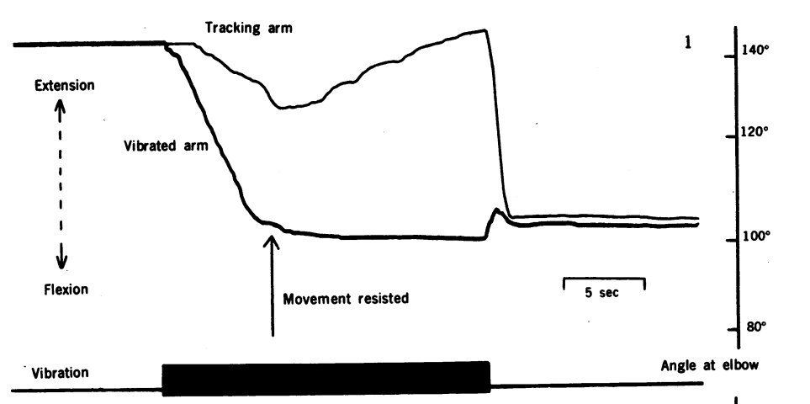
Prprioceptive illusion
Vibration of the flexor muscle tendon causes the arm to flex and a sense that the arm is being extended.
Goodwin Nature 1978 175:1382

Slide 10
Illusions teach about sensory processing
Vibrated tendon illusion
Excites muscle tendon organ
Signal indicates increased muscle tension
Increase muscle activation
Arm moves
But feeling increased tension continues
Feel like the arm is extending

Slide 11
Part 2
Expectations and the Motor System
Perceptual illusions reflect prior expectations
Motor pathways can remain accurate despite perceptual errors

Slide 12
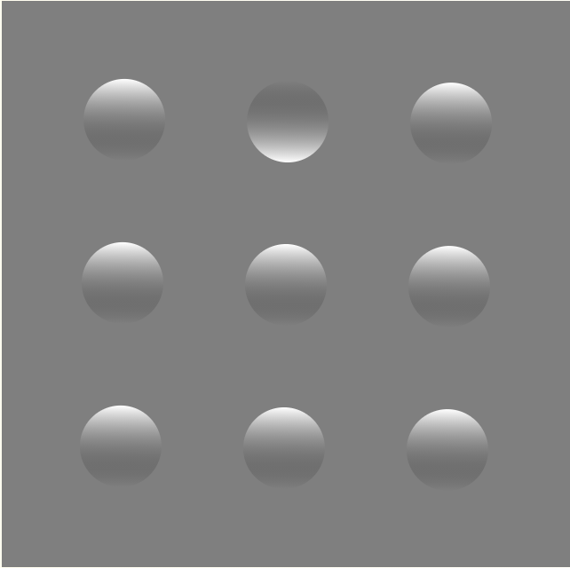
Illusions can reflect expectations
Light comes from above
Ramachandran Nature 1988 331:163

Slide 13
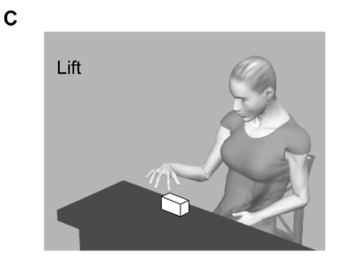
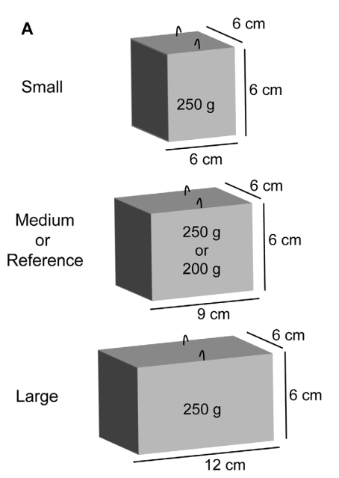
Size / weight illusion
Which box will feel heavier?
Plaisier PLOS One 2012 doi:10.1371/journal.pone.0042518

Slide 14
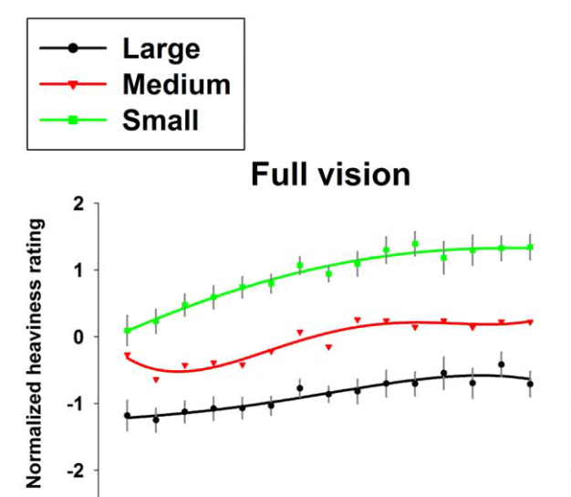
First reported in 1889
Buckingham PLOS One 2010 doi:10.1371/journal.pone.0009709

Slide 15
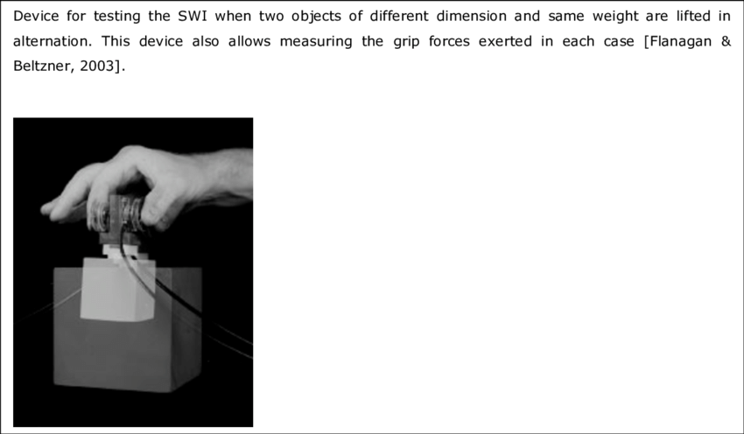
Is the motor system also fooled?

Slide 16
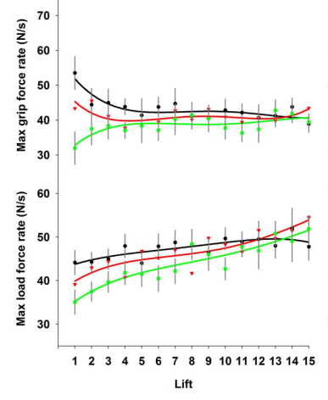
The motor system is not fooled
Buckingham PLOS One 2010 doi:10.1371/journal.pone.0009709

Slide 17
Explanations of the size weight illusion
Greater motor output makes heavy object feel lighter
Illusion persists after motor output adapts
Expected weight affects weight perception
Size-material illusion
Expectation can be reversed with enough practice

Slide 18
Part 3
Multisensory illusions
The brain integrates information from multiple sense
Flexible remapping across modalities

Slide 19

Illusions of multiple senses
The McGurk effect

Slide 20
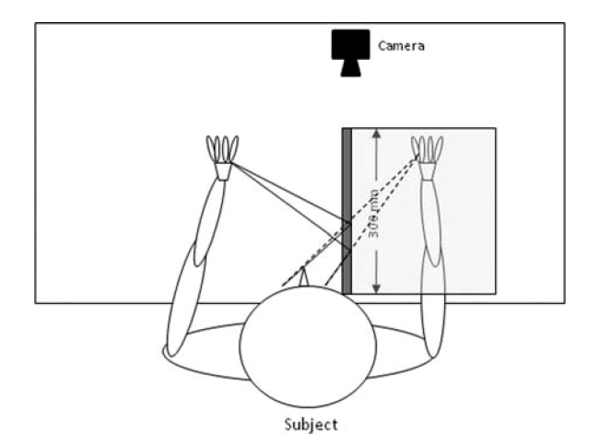
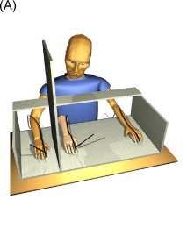
The mirror box and the rubber hand
Two illusions that give us the feeling we are seeing both hands

Slide 21

The mirror box illusion

Slide 22
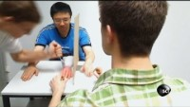
The rubber hand illusion

Slide 23
Part 4
Bayesian estimation in perception
The optimal combination of multiple sources of information
Each sense weighted by its reliability

Slide 24
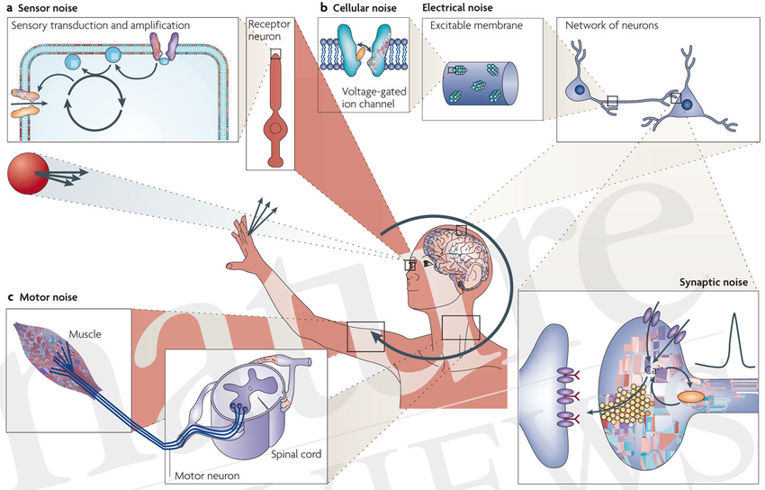
Senses combine in the face of noise
Faisal Nature Reviews Neuro 2009 doi:10.1038/nrn2258

Slide 25
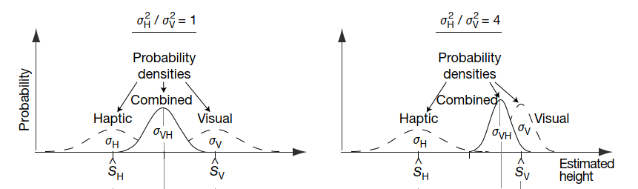
Noise levels affect optimal combination
We put more weight on the sensory input with less noise
Optimal combination is done using Bayesian estimation
Ernst Nature 2002 doi:10.1038/415429a

Slide 26
Bayesian estimation explains a lot
The role of expectations
Adaptation with repeated exposure
Weighting of different estimates

Slide 27
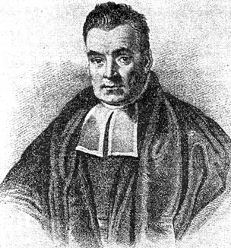

Bayes rule: optimally combining knowledge with experience
James Bernoulli (1713) asked:
Do rules of probability apply in inductive logic.
Dana Ballard (1999) asked:
Do inductive rules of probability govern what we perceive.

Slide 28
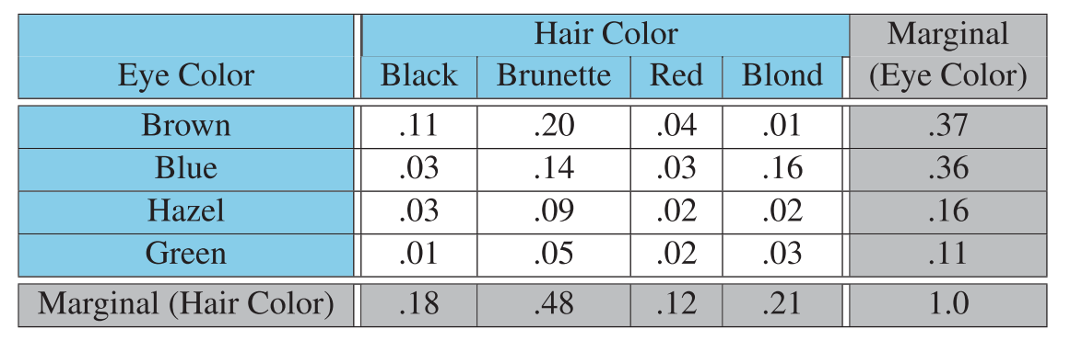
What is a joint distribution?

Slide 29
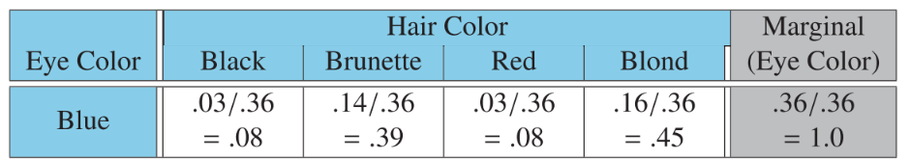
What is a conditional probability?

Slide 30
What is a conditional probability?

Slide 31
Baye’s rule

Slide 32
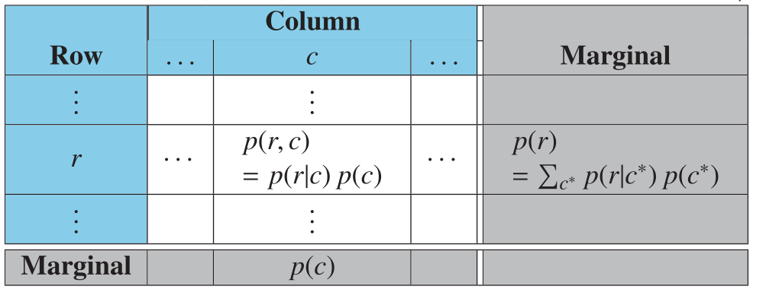
Baye’s rule from a table
By definition
Bayes rule

Slide 33
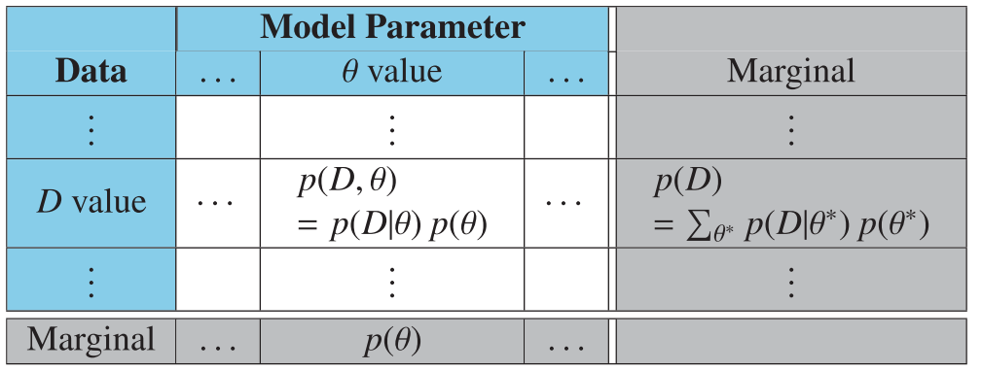
Applied to Estimation

Slide 34
Applied to new information
How likely is the data for different possible realities?
What did we believe before we saw the data?
What do we believe now that we did see that data?

Slide 35
Part 5
Bayes’ rule: examples

Slide 36
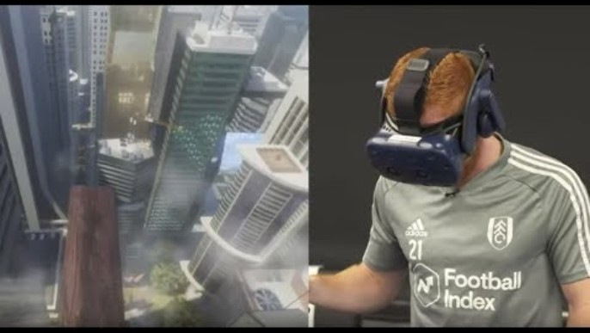
VR Plank Experience

Slide 37


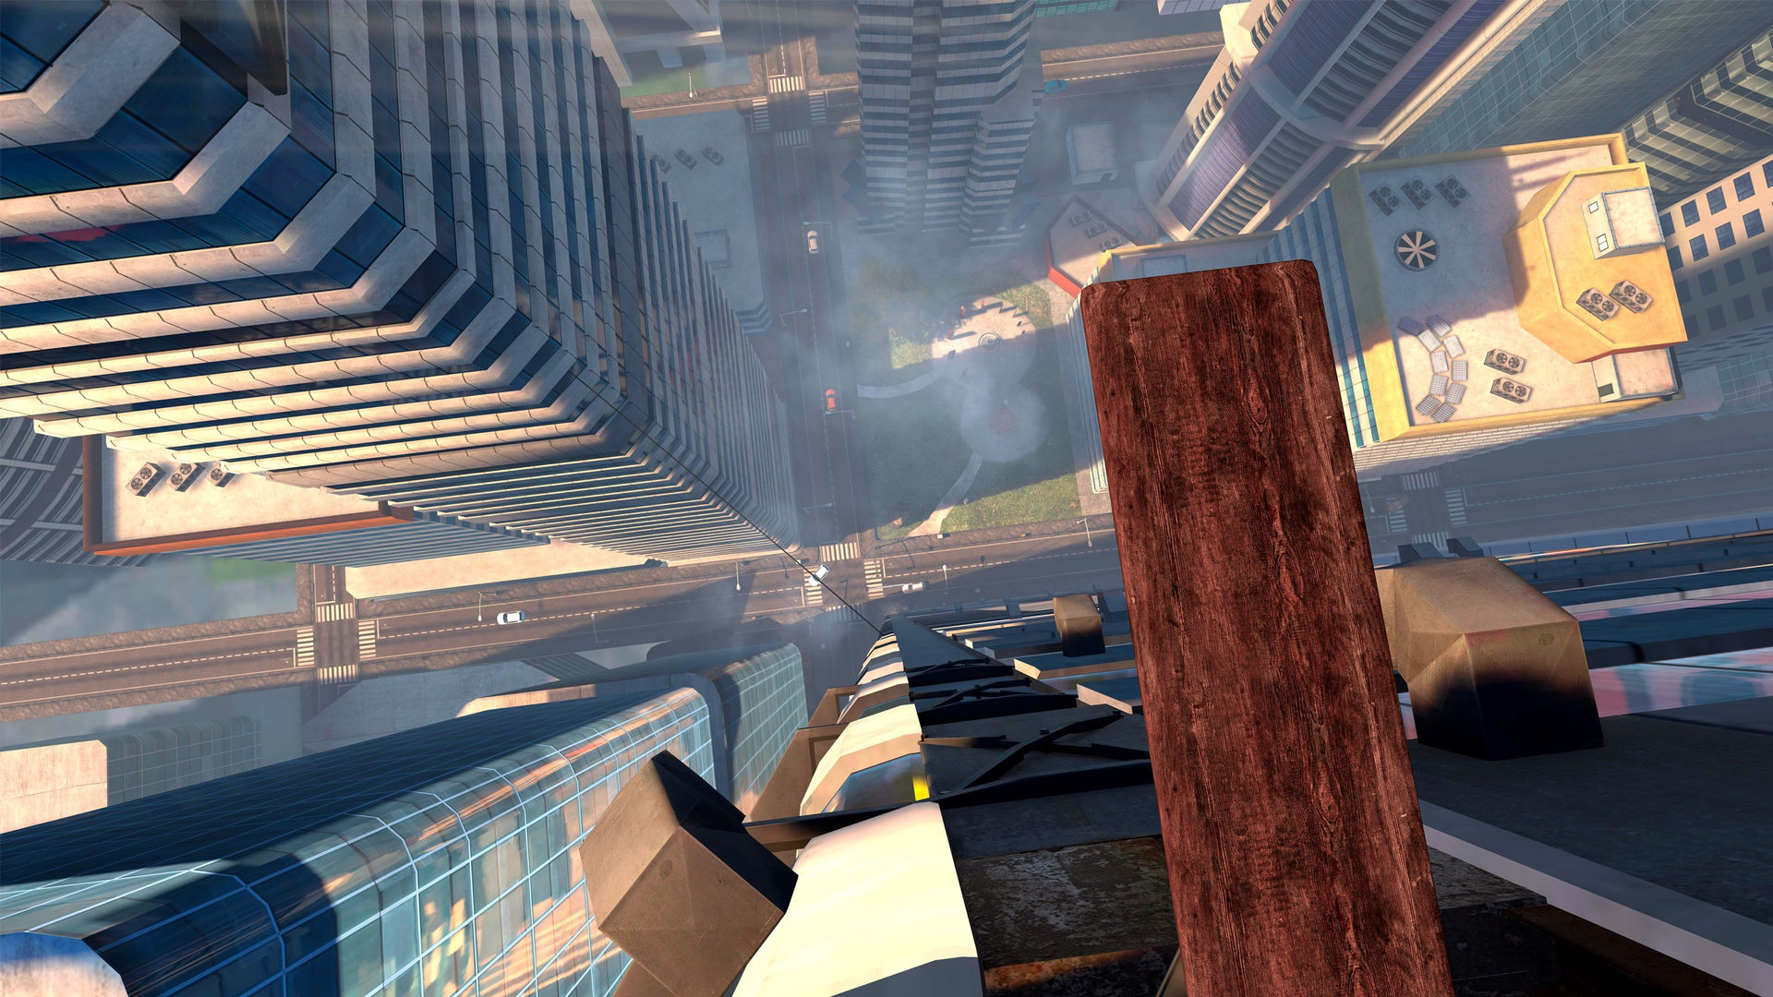
Prior information
You KNOW you are on the floor
You SEE you are on a plank in the air
+

Slide 38
Working through the calculations

Slide 39
The importance of multi-sensory integration
Input from multiple senses combines to make very strong likelihoods
The data from our senses ultimately overcomes our priors
Our sense create our reality

Slide 40
Bayesian updating explains adaptation
Initial grip force reveals expected weight
Change in grip force reflects updating

Slide 41
Simple example problem
I give you a (possibly biased) coin
Flip it N times, count z heads
What can you tell me about this bias of the coin?

Slide 42
The likelihood function
Probability of data given the parameter
This is a probability
For a coin with probability $θ$, the Bernoulli distribution

Slide 43
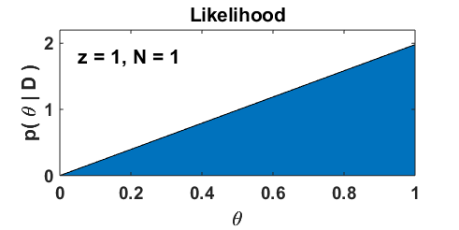
Coin flip experiment

Slide 44
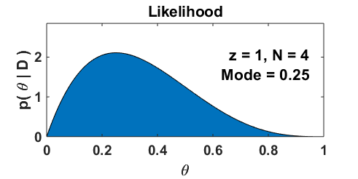
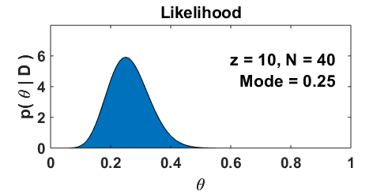
Multiple coin flips

Slide 45
The likelihood function
Probability of data given the parameter
Function of the parameter, given the data

Slide 46
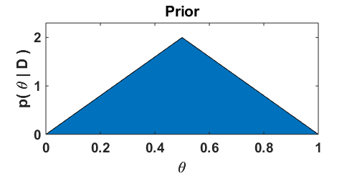
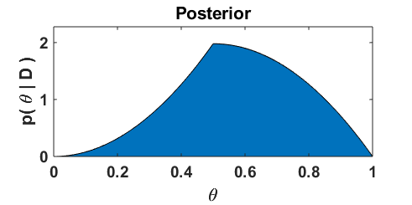
How will Bayes work?
Essentially, we simply multiply prior and likelihood
To get posterior

Slide 47
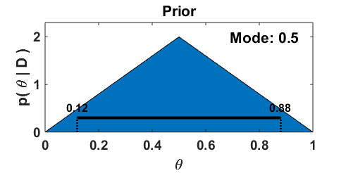
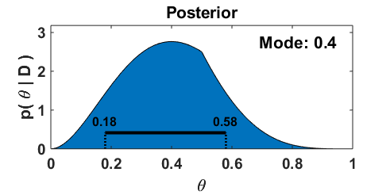
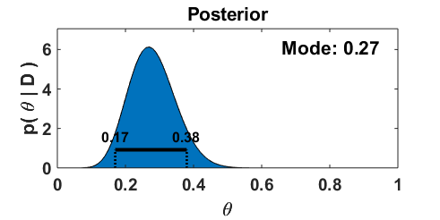
Multiple coin flips
As we add more data, the data will dominate the prior

Slide 48
The prior is a probability distribution
Must integrate to 1

Slide 49

Define the Beta distribution
A probability distribution on $θ$

Slide 50
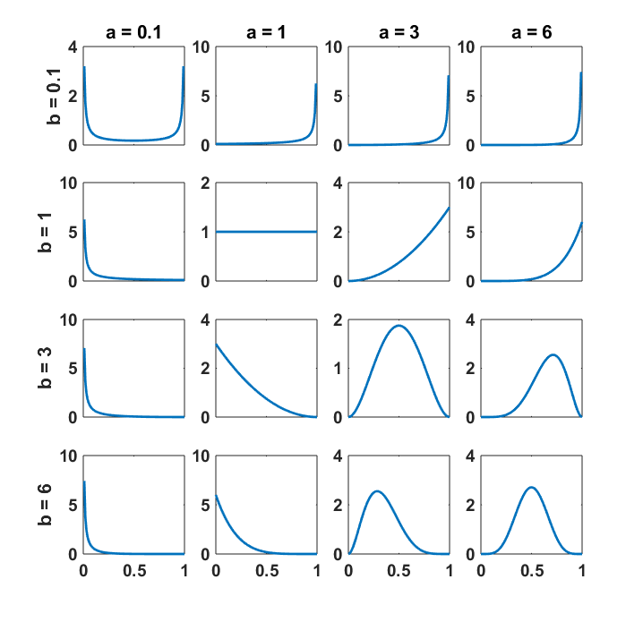
What does the Beta distribution look like?
A large variety of possible types of “plausible” probabilities
This might be a good family of priors!

Slide 51
What happens if you choose a beta prior?
We can use Bayes to find the posterior

Slide 52
What happens if you choose a beta prior?
We can use Bayes to find the posterior

Slide 53
Posterior is compromise of prior and data
Data mean
Prior mean

Slide 54
Posterior is compromise of prior and data
Data weight
Prior weight

Slide 55
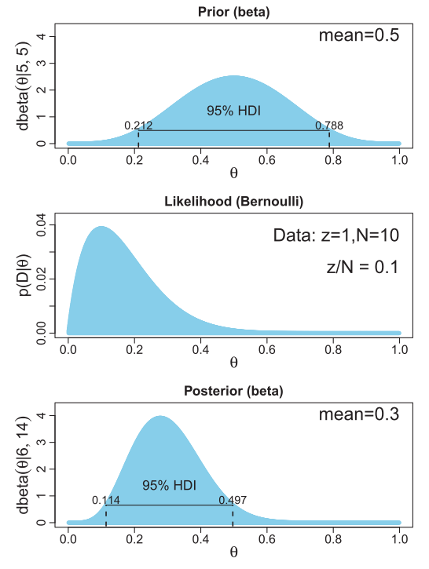
Showing how posterior is a compromise
Prior has concentration of 10
Likelihood is result of 10 flips
Posterior mean is right in the middle

Slide 56
Part 7
Bayes’ rule: Gaussian noise

Slide 57
Normal likelihood
For a $N$ data points, $x_{i}$, all with known “noise” $σ_{x}$

Slide 58
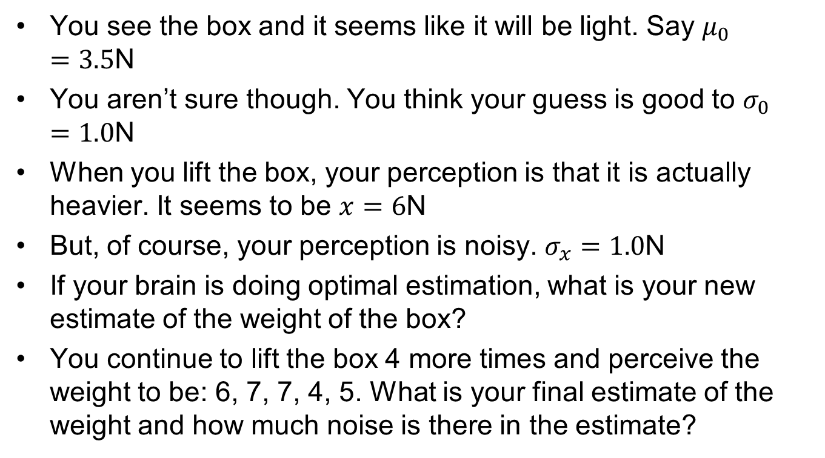
Exercise
You see the box and it seems like it will be light. Say $μ_{0}=3.5$N
You aren’t sure though. You think your guess is good to $σ_{0}=1.0$N
When you lift the box, your perception is that it is actually heavier. It seems to be $x=6$N
But, of course, your perception is noisy. $σ_{x}=1.0$N
If your brain is doing optimal estimation, what is your new estimate of the weight of the box?
You continue to lift the box 4 more times and perceive the weight to be: 6, 7, 7, 4, 5. What is your final estimate of the weight and how much noise is there in the estimate?

